Slide 1

SiloFuse
Cross-silo Synthetic Data Generation with Latent Tabular Diffusion Models
Aditya Shankar, Hans Brouwer, Rihan Hai, Lydia Chen

Slide 2
Synthetic data is everywhere
Predictive maintenance
Simulating crop patterns
Patient risk classification
Fraud detection

Slide 3
WHY synthetic data
Privacy
Mitigating class imbalance
Faster collection
Cheaper generation

Slide 4
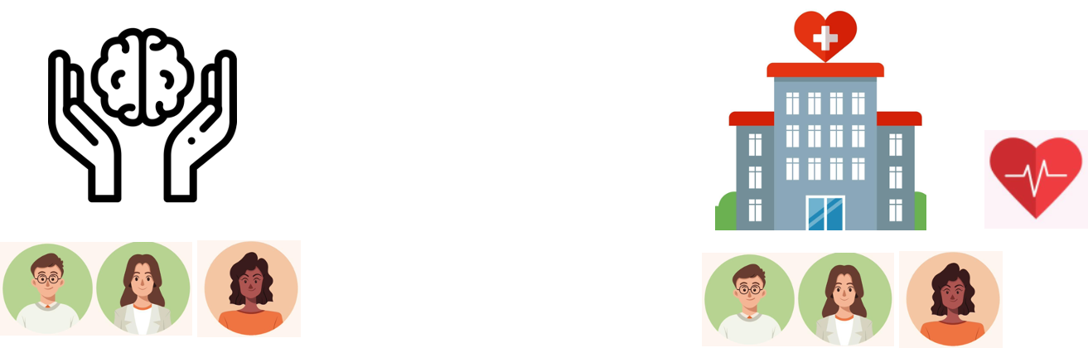
Our problem scenario
Dataset often distributed across silos
Our case: Vertically partitioned data
Feature partitioned data
Joint learning beneficial
High rate AND high stress = higher risk
How to synthesize?
Patient ID | Stress level
#78349 | High
#21567 | Low
#32171 | High
Patient ID | Heart rate
#78349 | 80
#21567 | 67
#32171 | 110

Slide 5
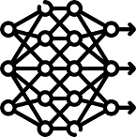
Naive solution
Centralise then synthesise
Patient ID | Heart rate
#78349 | 80
#21567 | 67
#32171 | 110
Server
Synthetic data
Patientt ID | Rate | Stress
#78349 | 80 | High
#21567 | 67 | Low
#32171 | 110 | High
Generator
Patientt ID | Rate | Stress
#02334 | 91 | High
#44212 | 105 | High
#31079 | 76 | Low
#22125 | 66 | High
Patient ID | Stress level
#78349 | High
#21567 | Low
#32171 | High

Slide 6
Challenges

Slide 7
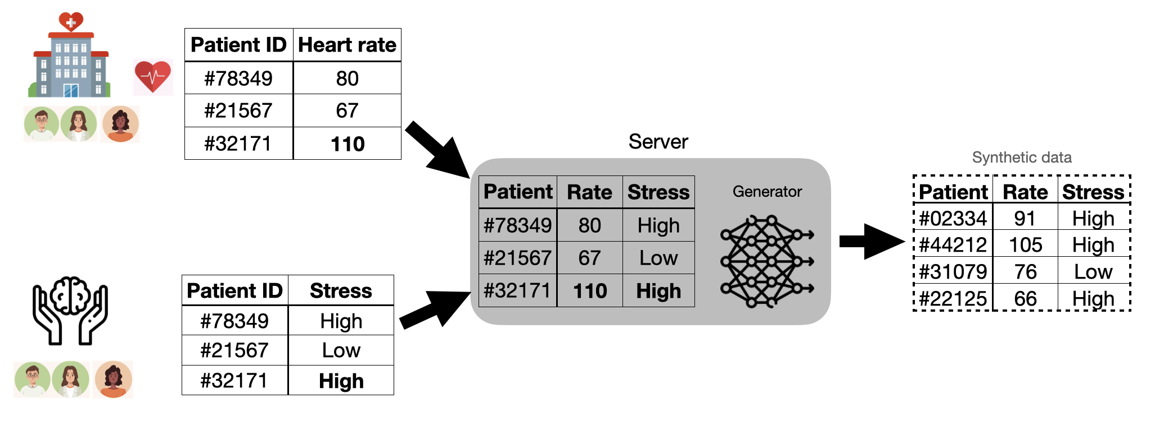
# 1 Data Privacy
Centralizing violates privacy
Who plays the server role?
Train without moving data?
Federated Learning? Encryption?

Slide 8
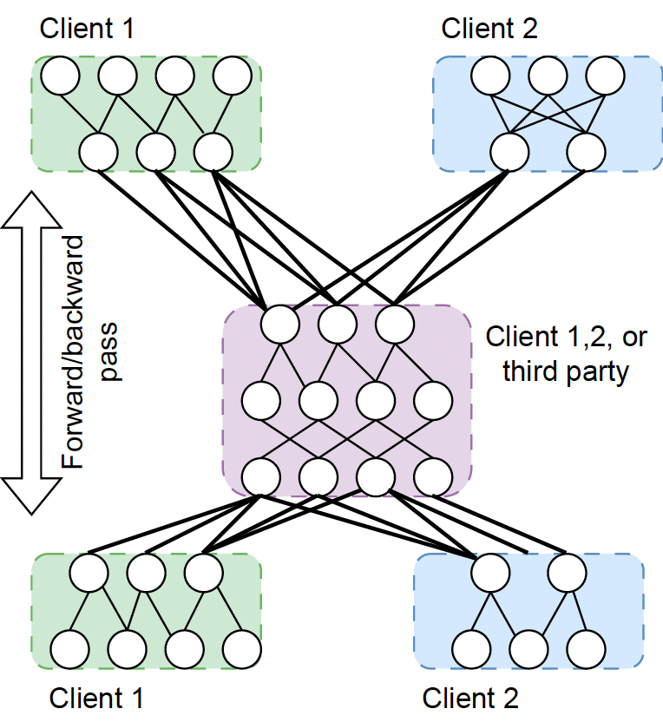
#2 Model training
Without moving data
Keep data local: Federated learning
More iterations —> More comm.
Improve training efficiency
Comm. boundary
Generative model

Slide 9
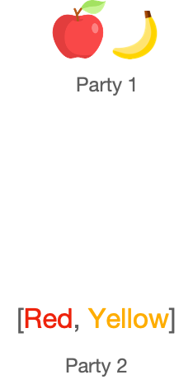
#3 What generative models?
Classic: Bayesian, Variational autoencoders (VAEs)
Generative Adversarial Networks (GANs)
Unstable training
Capture feature links across silos?
Need stable generator while preserving cross-silo associations

Slide 10
Solution

Slide 11
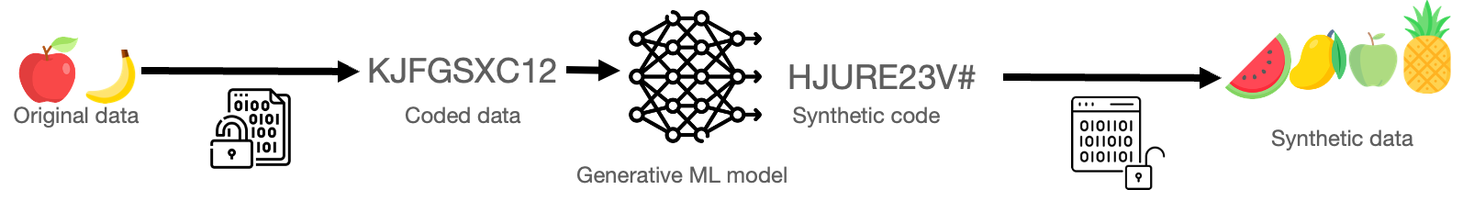
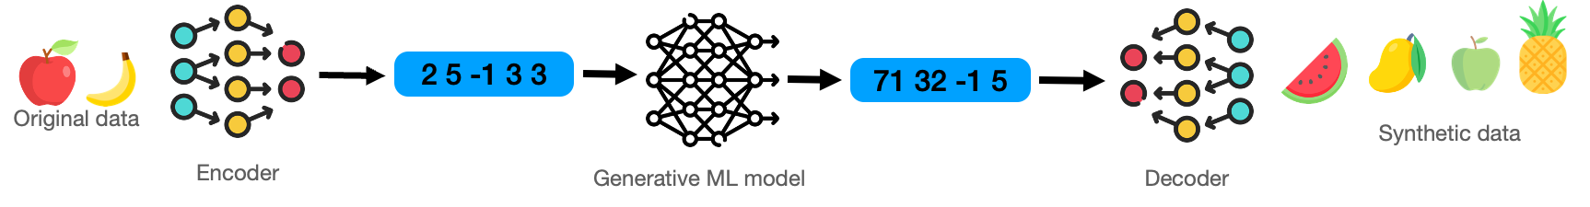
# 1 Data privacy
Latent models
Inspiration from cryptography
Latent generative models
Model is the “key” to your data

Slide 12
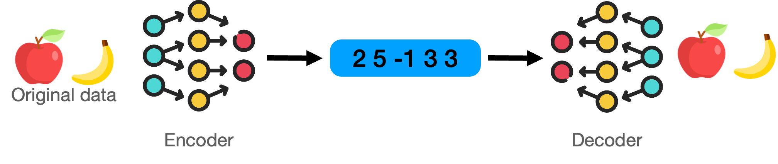
#2 Model training
Stacked training
Step 1: Local training (client)
Step 2: Latent generator training (server)

Slide 13
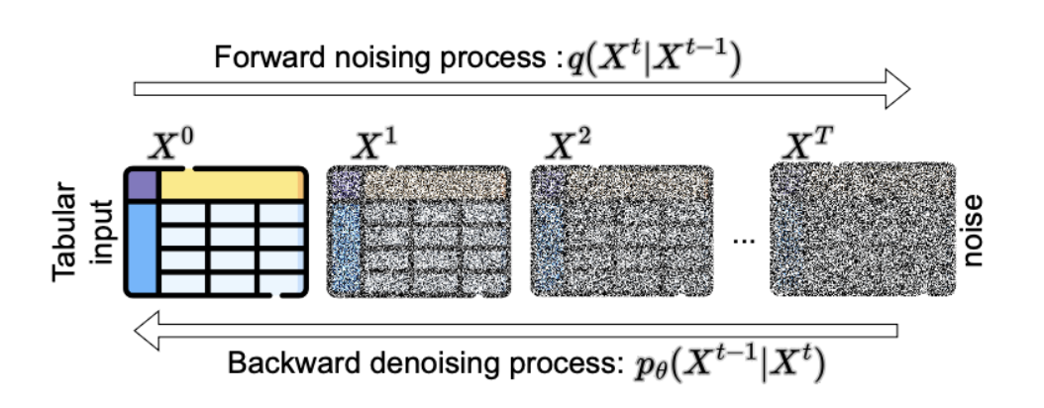
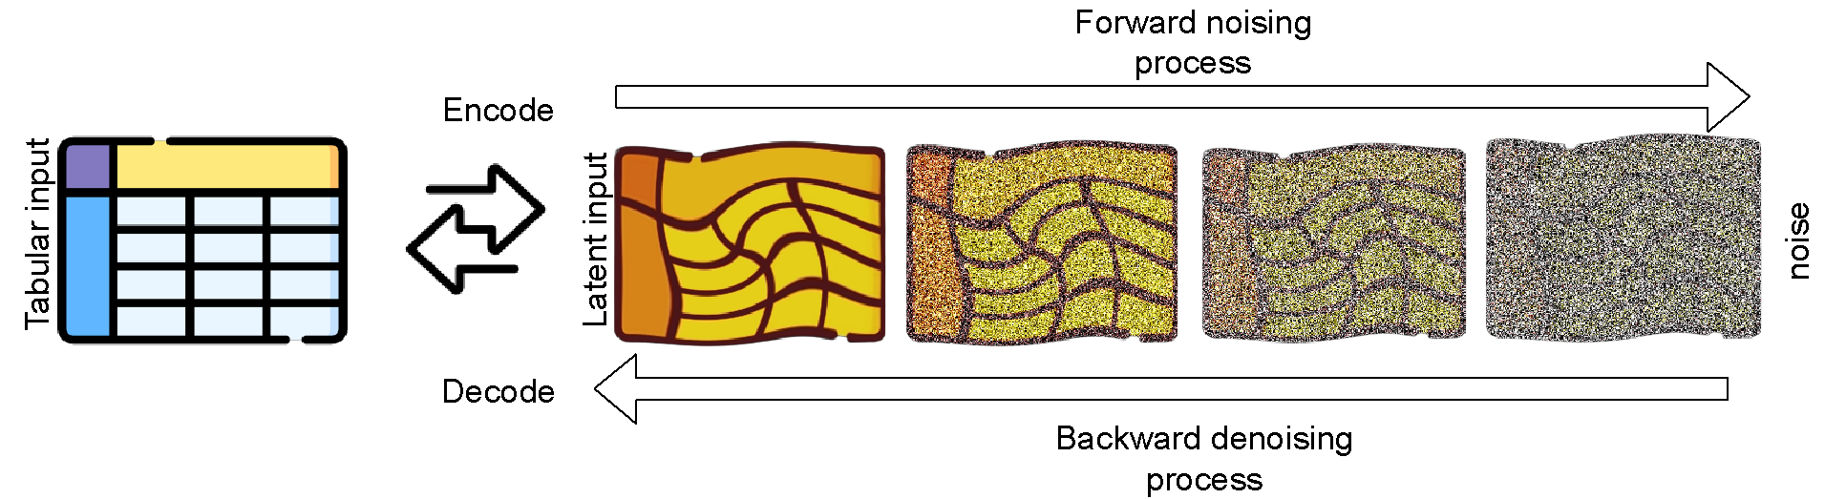
#3 Generative model
Tabular diffusion
Stable training process
Privacy? Latent tabular diffusion

Slide 14
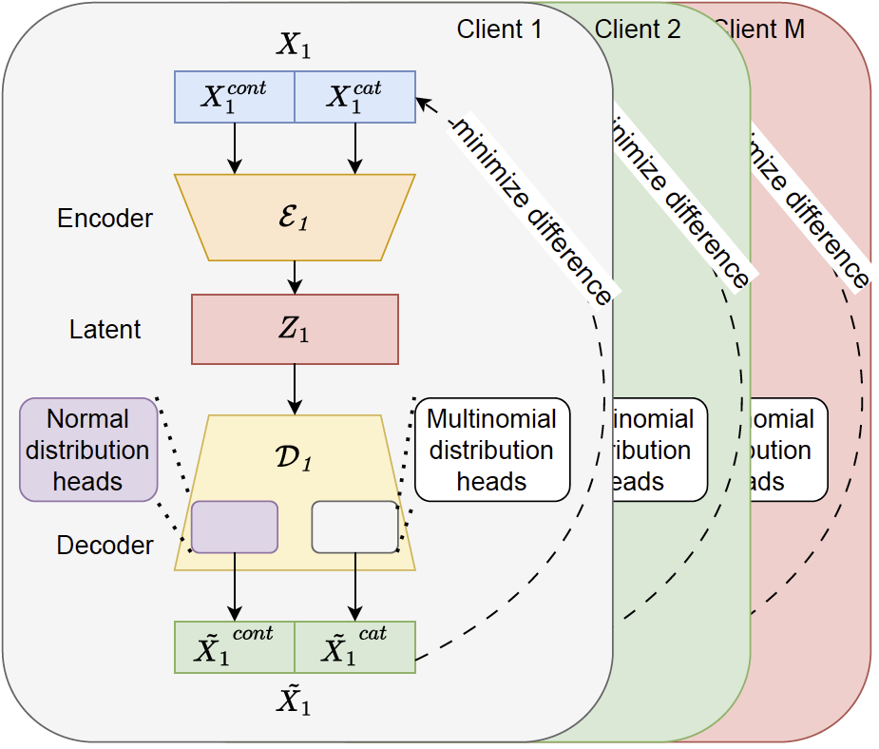
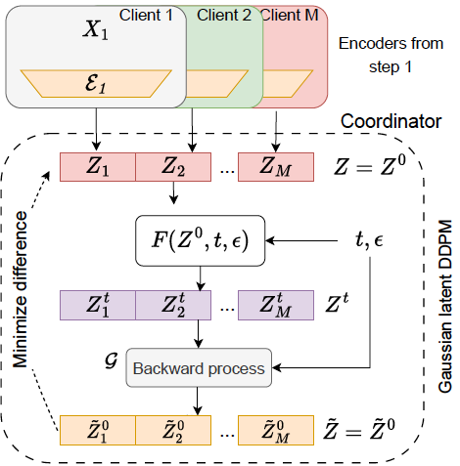
SiloFuse
Training
Step 1: Auto-encoder(s)
Step 2: Latent Diffusion

Slide 15
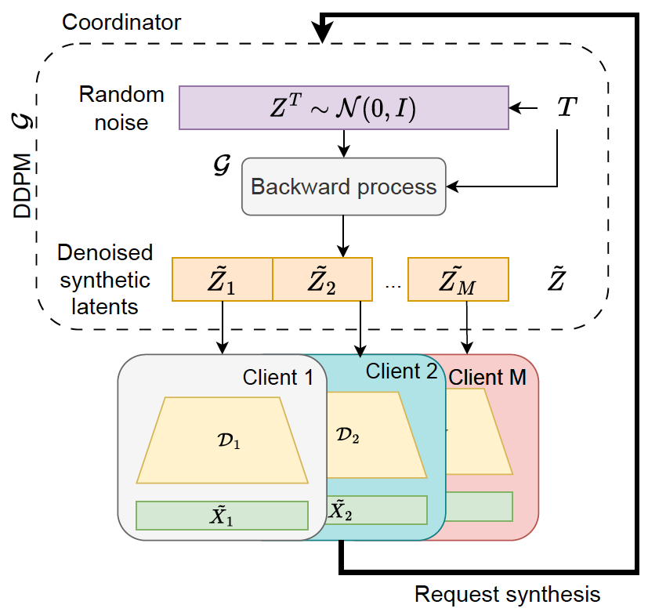
SiloFuse
Synthesis
Two scenarios
Share post synthesis (weaker privacy)
Retain vertical partitioning (stronger privacy)

Slide 16
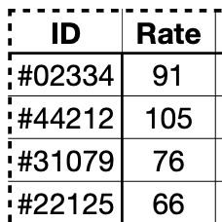
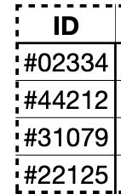
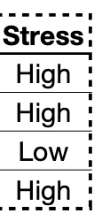
Privacy
Semi-honest
Vertical partitioning post synthesis: Theoretical irreversibility
Quantify risks of sharing post synthesis (3 attacks)
Single out rows
Links between rows
Infer other columns from local ones
exchange
Party 1
Party 2

Slide 17
Experiments

Slide 18
Resemblance
Similarity between real and synthetic distributions
Avg. of 5 metrics
Column similarity (correlation)
Probability distribution distance
External discriminator model
6 baselines. 9 datasets
Centralized GANs, Stacked vs End-to-End, Centralized diffusion

Slide 19
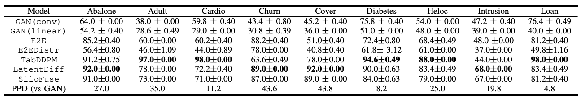
Resemblance
Diffusion outperform GANs
Latent models competitive against centralised diffusion

Slide 20
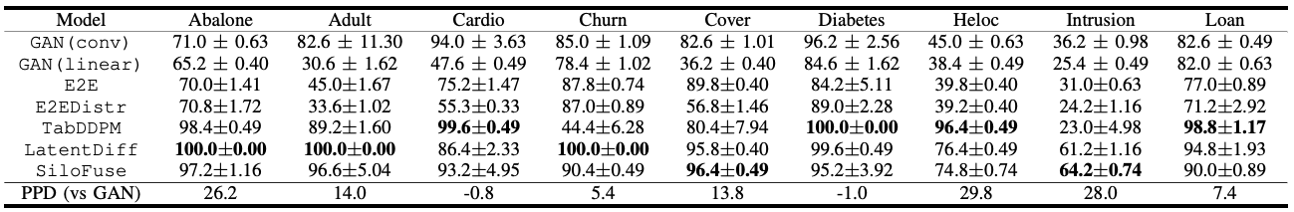
Downstream Utility
Ratio of classifier accuracy - synthetic : real (capped at 100.0)
Diffusion outperform GANs
Comparable to centralized auto-encoder and diffusion

Slide 21
Privacy
Tradeoff
Recommendations:
Strong privacy —> Retain partitioning. FL on downstream
Weaker guarantees —> Share post synthesis. Local model downstream

Slide 22
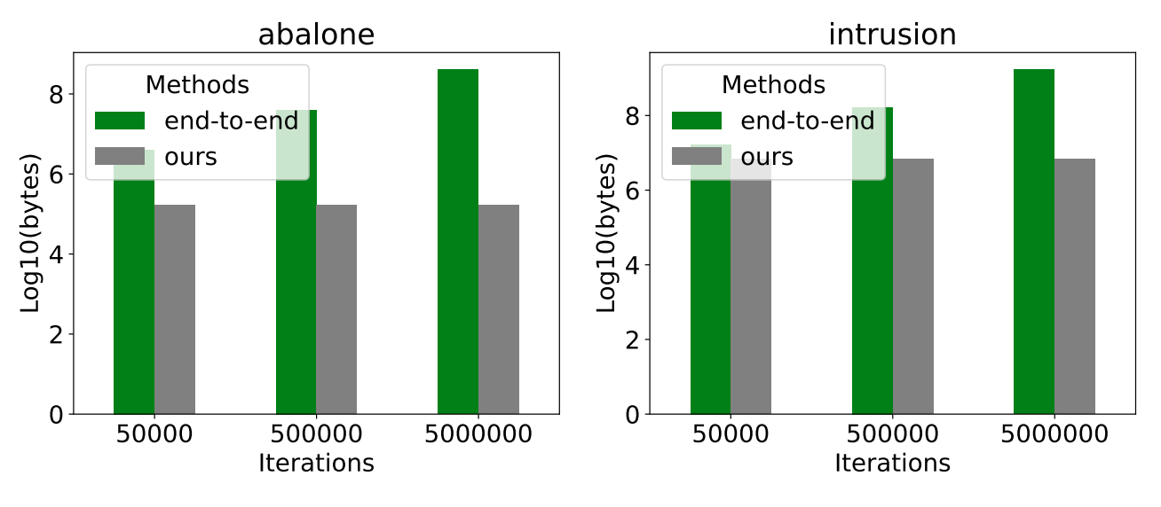
Communication
Stacked vs End-to-end training
Bytes transferred during training
End-to-end training: Increasing iterations —> Increasing comm.
Stacked training: Single comm. round
Fixed cost should be the takeaway point

Slide 23
Future work and Conclusions

Slide 24
Conclusions
Synthesize, yet maintain privacy
Latent architecture
Links in real space preserved in latent space
Efficient training paradigm
Privacy
Spectrum
Tradeoffs involved

Slide 25
Future work
Beyond tabular data
Malicious adversaries
Distributed servers

Slide 26
Thank you

